Slide 1
Data Structures and Algorithms IICT-6005
Stacks

Slide 2
Lesson Content
What is a Stack?
Operations of The Stack ADT
Implementing Stacks using Array Based Vectors
What is a Queue?
Operations of The Queue ADT
Implementing Queues using Array Based Vectors

Slide 3
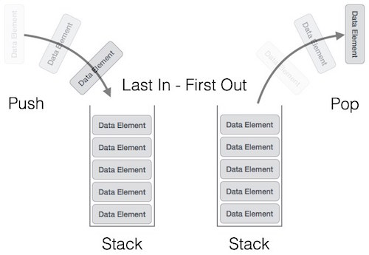
What is a Stack?
A Stack is an abstract data type that serves as a collection of elements.
Elements come off a stack in a last in, first out order (LIFO)
This means that, unlike a Vector, elements in a stack can only be accessed in a restricted manner as mentioned above

Slide 4
The Operations of Stack ADT
A Stack performs two principal operations:
Push
Adds an element to the collection at the head (top) of the Stack
Pop
Removes the element at the head of the Stack i.e. the most recently added element.
A stack does not have the GetElementAtRank, InsertElementAtRank and RemoveElementAtRank operations; these are not in line with the LIFO order implemented by the Stack.
Additionally, a Peek operation may access to the top element in a Stack but without modifying it.

Slide 5
The Operations of Stack ADT
int Size( )
Returns the number of elements in the Stack
bool IsEmpty( )
Returns true if the Size is 0, false otherwise
void Push(object o)
Places the object o at the start of the sequence of items
object Pop( )
Removes the item at the start of the sequence of items and returns it
object Peek( )
Returns, but does not remove, the item at the end of the sequence

Slide 6
Implementing a Stack
A stack can be implemented using a number of data structures.
It can also be implemented using an ArrayBasedVector.
Exercise:
Implement a stack data structure and use aggregation of an ArrayBasedVector to implement the stack operations.

Slide 7
What is Queue?
A Queue is another abstract data type that serves as a collection of elements. It is related to Vectors.
Elements come off a queue in a first in, first out order (FIFO)
Queues are a very popular data structure in computer science.
They are used in:
Keeping track of tasks to be completed in first-in-first-out order (FIFO);
Buffers (e.g. for writing to hard-disk)
Messages being passed from one system to another.

Slide 8
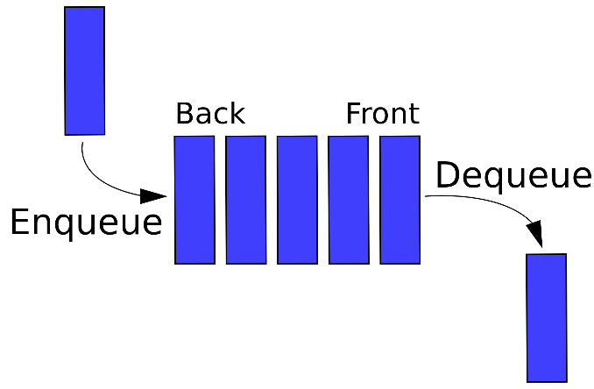
The Operations of Queue ADT
A Queue performs two principal operations:
Enque
Adds an element at the back of the Queue
Deque
Removes the element from the head of the Queue.
No elements may be inserted or removed from the middle of the queue

Slide 9
The Operations of Queue ADT
int Size( )
Returns the number of elements in the Queue
bool IsEmpty( )
Returns true if the Size is 0, false otherwise
void Enque(object o)
Places the object o at the end of the sequence of items
object Deque( )
Removes the item at the head of the sequence of items and returns it

Slide 10
Implementing a Queue
A queue can be implemented using a number of data structures.
It can also be implemented using an ArrayBasedVector.
Exercise:
Implement a queue data structure and use aggregation of an ArrayBasedVector to implement the stack operations.

